Slide 1


Let’s Talk About Sex!
Sexuality & Developmental Disabilities:
A crash course for parents and caregivers
Marsha Stepensky Dorn, MS.Ed, BCBA
PG County Parents of Children with Down Syndrome – June 7, 2021

Slide 2
Who am I?
My name is Marsha and I live in Washington, DC (born and raised in Rockville, MD!).
I am the first American born in my family; my father is from Moscow, Russia and my mother is from Kiev, Ukraine.
I have been working with adolescents and adults with developmental and intellectual disabilities for twelve years.
I am currently enrolled with the Sexual Health Alliance working toward my national certification as a Sexuality Educator.
I got married on Oct 10, 2020! (10.10.20, get it?)

Slide 3

But first…

Slide 4

True or False?
Sex education is just talking about sex/teaching sex
Notes:
The ‘sex’ part of sex education is a tiny slice of comprehensive sex education. We teach about bodies, hygiene, friendships, decision making, boundaries, and so much more. Good, quality sex education prevents things we want to prevent and promotes things we want to promote.

Slide 5
True or False?
Teaching sex/sexuality ed basically gives people permission to become sexually active
Notes:
NO! So false. We have data that tells us that in fact, young people who access comprehensive sex education wait longer to engage in sexual activity and are more likely to practice safer sex. In teaching this information we are not ‘giving permission’ to have sex. We are informing young people about their bodies and their health; we are empowering them by educating them.

Slide 6
True or False?
People with intellectual and developmental disabilities don't need sex education
Notes:
False. This one is the hardest of the myths for me – education (regardless of the topic) is human right for everyone. We will talk about this more later

Slide 7




DISCUSS
the importance of comprehensive sexuality education and misconceptions surrounding sexuality education.
LEARN
about human sexual development and developmental disabilities
GAIN
knowledge about specific topics included in a comprehensive sexuality education curriculum
SHARE
tips and resources to help you and your child
Notes:
Thank you for completing the pre-meeting survey. It was really helpful for me to see who is here, read about your family, and learn about your familiarity and comfort with this topic. We are a diverse group in the sense that we have some people with adult-age children, school-aged, and younger. We have some people who are quite comfortable with these topics and we have some people for whom this is all new! You were all very thoughtful in your responses and hopefully this workshop will be helpful to you.

Slide 8
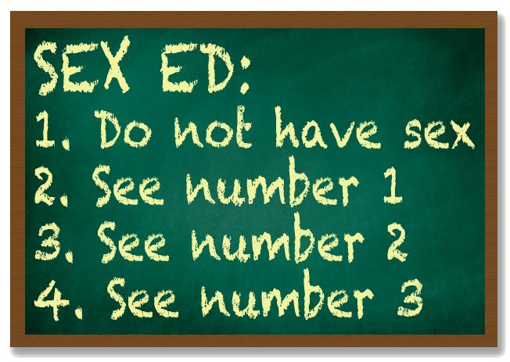
It’s an opportunity for you to built trust with your child, share your values and beliefs, and be open and sex positive.
People with ID/D are people and like all people, individuals with ID/D have the right to learn all they can to enable them to become sexually healthy and make informed decisions for themselves.
Schools are not required to teach sex education/sexuality education.
Reduces risk of sexual abuse.
Normalizes the topic.
Education = Empowerment and Prevention
Notes:
This list is endless, but here what I consider to be five reasons this topic is so important. The fact that you are here, being present at this workshop, means you recognize the importance of this. Whatever the reason that brought you here tonight, you are here and that's what matters. So kudos to you!
1. Build trust, share your values/beliefs surrounding sex and sexuality, to show your open and that when they come to you, they won’t feel shame. We don’t have time to delve too deep into messaging, but there is so much negative messaging surrounding sexuality and sexual health – especially in relation to ID/D – being open and sex positive is a really powerful way to combat all those negative messages. You want to be the primary source of information when it comes to this topic. Because if they aren’t asking you…then they’re going to the internet, which can be a helpful place and also a scary place. Or, they’re getting incorrect information from TV/movies/other people in school etc. This will sound morbid but….foster this opportunity while you are still alive. Provide them information, show how them to find information, be their own sexual self-advocate, and build a community that can support your child in your absence.
2. It’s a right. Remember, sex ed is more than just sex. People have a right to know and understand their bodies; to learn healthy habits; to truly understand the difference between consenting and complying.
3. In the US, only 23 states mandate sex education; less than half. Of those states, only 13 require the use of a comprehensive, medically accurate curriculum. Sadly, even in the places offering sex education, young people with ID/D are often excluded from this part of their education or they receive a watered down version of sex education. It is recommended that about 60% of sex education happen in the home, 30% can happen in the context of school/day program/etc. That is not a concrete ratio, that is the recommendation of Peter Gerhardt, but I do endorse that ratio. Write down his name – spell out – he’s an expert in this field
4. Reduces risk – this is a dark reality that we can not ignore when we are talking about this population. Sex education isn’t just about teaching all the awesome positives of development, it’s also teaching self-protection. It’s teaching young people that refusing to be touched is a right and they can say NO. We can’t report abuse if we don’t know what it is, if we can’t label our body using medical terms. David Hingsberger (that’s a name you’ll want to write time, I’ll mention him a few other times) developed a framework, Ring of Safety, to help people with disabilities be their first line of defense, and exposure comprehensive sex ed is number 1.
5. Normalizes topic – simply, the more we talk about it, the less taboo and uncomfortable it will feel. We know the idea of ‘if we talk about IT, then they will do IT’ is not true. We need to stop treating this topic as something that is optional for people with ID/D, and when we educate our young people on their bodies and health, we are empowering them and protecting them from harm.

Slide 9
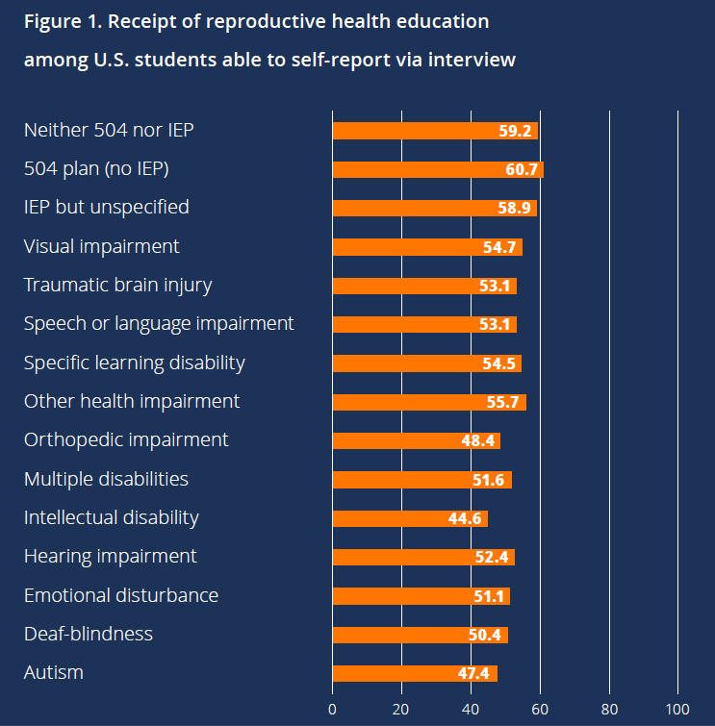
The Sex Ed Gap
Source: “National Longitudinal Transition Survey 2012” (NLTS-2012). U.S. Department of Education, National Center for Education Statistics.

Slide 10
Sex Positive Talks to Have With Kids: A guide to raising sexually healthy, informed, empowered young people
By: Melissa Pintor Carnagey, LBSW
Notes:
Really excellent book – highly encourage you all to get a copy. You can order it on Amazon, it’s a really great book. Easy to read, offers practical tools like conversation starts based on different ages and topics. It also is interactive, in that there are opportunities for you as a parent to do some self-reflection. Can’t recommend this enough

Slide 11





Birth – Childhood
Development of biological sex
Adolescence
Puberty
Adulthood
Gender roles reinforced
Curiosity with genitals*
Exploring/touching genitals* (with hands or on objects)
Interest in seeing others naked/being naked in front of others
Increased need for privacy
Playing games that involve sexual behavior (doctor, family, etc.)
Beginnings of sexual attraction/interest in people
Development of attitudes and beliefs about sexuality
Body changes – body hair, breasts, pimples, etc
Friendships, romances
Sexual feelings (like/love/’tingle’)
Sexual expression
Sexual orientation
Sexual identity
Solo Sex (masturbation)
Body image
Heartbreak
Pregnancy, STIs, contraception
Pregnancy, childbirth, parenting
NOT getting married/having children
Infertility
Establishing and maintaining intimate relationships
Separation/Divorce
Menopause
Changes in sexual functioning
Laws regarding sexuality
Laws regarding sexuality
Everything from before PLUS…
Marriage
Notes:
Typically think of “sexual development” as puberty, but really sexual development is a process that occurs throughout the lifespan, so let’s do a quick overview of what that looks like…
Sexual development starts in utero with the development of our biological sex. hen I say biological sex, I am referring to the sex organs a person is born with – labia, vagina, ovaries, penis, testicles
When a baby is born (and now, it is common to do this before the baby is born), we look in between its legs and say “It’s a ____!” We assign the baby it’s gender.
Once the gender is assigned, we start to teach the child how to act like a girl or act like a boy. These are the societal gender roles or norms. Along with being taught how to act and be like a girl or a boy one’s gender identity develops. This is one’s innate sense of being male/female or other. Most of the time one’s biological sex matches their gender identity, but not always. One usually establishes their gender identity around age 3 or 4. I bring this up because young people with developmental disabilities also identify as gay, lesbian, trans, nonbinary, etc. It is not something unique or specific to the neurotypical population.
Notice asterisks near genital play – at some point, children discover their sex parts and they’re naturally curious about it. It’s a perfectly normal and healthy part of development, it’s curiosity based. We view it as erotic because we observe the behavior through our adult eyes
Another part of one’s sexual development is learning about love, relationships, friendships, touch, intimacy, bodies. These are influenced by a combination of individual (how do I feel), family (the starting point), cultural (the larger picture), legal (what does the law say – varies place to place), religious, professional and institutional factors. Parents teach values and attitudes early on in a young person’s life. Values may change, but we learn them from our family earlier than most people realize.
Adolescence is a time of many changes – physical, social, emotional.. In girls puberty normally beings after age 8 with the biological process largely completed by age 16. In boys puberty normally begins at age 9 and is largely completed by age 18. Beyond hormone changes, hair growth, and all those other fun body changes, puberty is a time when we are learning about relationship dynamics (friendships and romantic), we begin exploring our sexuality, sexual desires, solo sex. We also usually experience our first heart break in adolescence.
Adulthood – this is a time we experience our greatest amount of independence; many people get married, have children and some people don’t. In adulthood we often experience stresses related to relationships/friendships, finances, employment, etc. We may also experience changes in our sexual functioning as we age

Slide 12
What Does Sexual Health Mean?
I feel good about myself and my body.
I understand my body, the different parts, and how they work.
I have good self-esteem.
I feel good about my gender identity and sexual orientation.
I have relationships (romantic and platonic) that are healthy, positive, and make me happy.
I have access to sexual health information so I can make healthy decisions about my body.
I have access to sexual health information so I can avoid STIs, unintended pregnancy, and other challenges.
Notes:
There are a lot of definitions for “sexual health” but this list comes from a group of young adults with disabilities, Green Mountain Self-Advocates

Slide 13
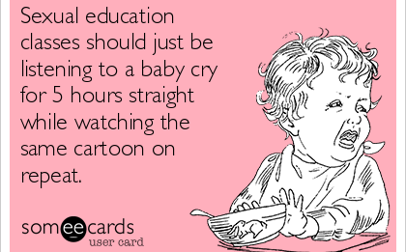
Notes:
We have a tendency to be very reactive in our approach to sex education and addressing sexualized behaviors. Typically, we don’t intervene until SOMETHING happens – Marsha groped her DSP; Jason disrobed in the cereal aisle of the grocery store; etc. We need to be proactive in our efforts (this applies to typical children as well). We need to start these lessons and conversations when adults are still children – sexual behaviors are social behaviors, and we need to treat them as such.
Moreover, this is not a topic that stops after one conversation, after reading a book one time, or after that behavior is “managed” Sex education is on-going – we just saw how humans are developing sexually throughout the course of our lives. So why do you we make sex ed situational? We don’t require it as part of our education; when we do teach it, it’s taught to a specific age group (middle-HS) for a specified time frame (2 weeks, 1 month, 1 semester); it’s never revisited again unless the individual decides to learn more information about their sexual health, needs, etc.
We need to be proactive! So where to start?

Slide 14
Important Concepts
Preschool - Elementary
Adolescence – Adulthood
(the learning never stops!!)
Body Parts/Functions*
Boys vs. Girls
Public vs. Private
Introduction to puberty/body changes
Appropriate vs. Inappropriate touching
Hygiene
Toileting
Dressing
Avoidance of danger
Decision Making
Saying NO
Secrets about being touched are NOT OK
Puberty
Consent (self and others)
Decisions Making
Saying NO
Menstruation, ejaculation, ‘wet dreams’
Solo sex
Public Restroom Use
Gender Identify, Sexual Orientation
Attraction, sexual feelings, friendships, relationships, dating, break ups
Laws regarding sex, sexuality, consent
Pregnancy, safe sex, birth control
Personal Responsibility, decision making
Social Skills – ‘Hidden Rules,’ bathroom etiquette, flirting vs. harassing, etc.
Notes:
Decision Making, saying no, consent are in green because those concepts can (and should) be taught outside of the context of sexuality.
You’re not going to be able to make decisions surrounding sex if you can’t decide what you want to eat for lunch. You can’t say no to a sexual advancement if you can’t say no to broccoli. Dave Hingsberger said this, it’s my favorite quote of his – If you can’t say no to peas, you can’t say no to penis. We live in a compliance culture and it’s dangerous, we don’t teach children how to appropriate protest things they don’t like or don’t want. WE (capitalized W-E), parents and professionals, have to also be mindful of the linguistic difference between choice and demand – people will phrase a demand in the form of a question and when the person says NO, we make them comply anyway. What type of message does that send? (i.e. do you want to wash the dishes?) Asking a question, implies choice.
The idea of teaching you child to say no, may seem like a nightmare and I’ve personally run non-compliance programs where we’re teaching NO and the person is not refusing everything and that’s we work through. But I would much rather work through that when they’re young and feel confident when that person is 16 years old, he or she know to say NO to an abuser. AND that abuser will know that our young person is aware that their body under their control and they control who touches them. That is truly powerful.
Social skills are in purple because Sexual behavior is social behavior, and we need to address them as such. We need to incorporate the social dimension into sexuality education as much as possible because they are connected.

Slide 15
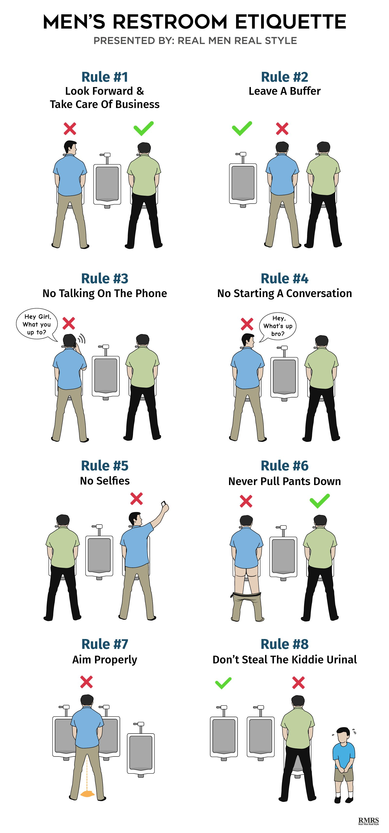
Notes:
Look at all those rules just to use the men’s bathroom – most of them seem obvious, others are not like the buffer rule. You’re supposed to always leave at least 1 urinal between you and another person (actually, it’s as many as possible but at least one).
Guys – how did you learn these? Did you someone sit you down and teach you? You most likely learned through your natural environment; going to the bathroom with your father/brother/uncle and they would explain what to do; OR you go to the bathroom with friends, accidentally use the urinal right next to them, and then you get a lot of grief from your friends for making the error.
So many of these sorts of rules exist – we don’t usually think about them because they are hidden rules. They’re these secret rules and the only reason we know about them is because either we make an error and are made fun of, laughed at, whatever OR someone else makes an error we see the reaction from others (or ourselves). So we learn through the natural environment and through social interactions what we’re supposed to do and what we’re not supposed to do. This is a really important point because our young people with ID/D, often, don’t have the same social opportunities as their typical peers. They don’t get invited to sleepovers, where kids talks about crushes and friendships. We learn about all the different hidden rules through those experiences.
So, how can our young people learn these rules...

Slide 16
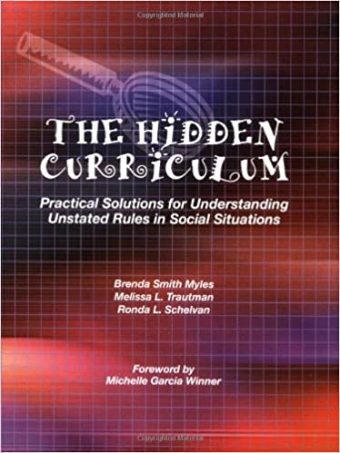
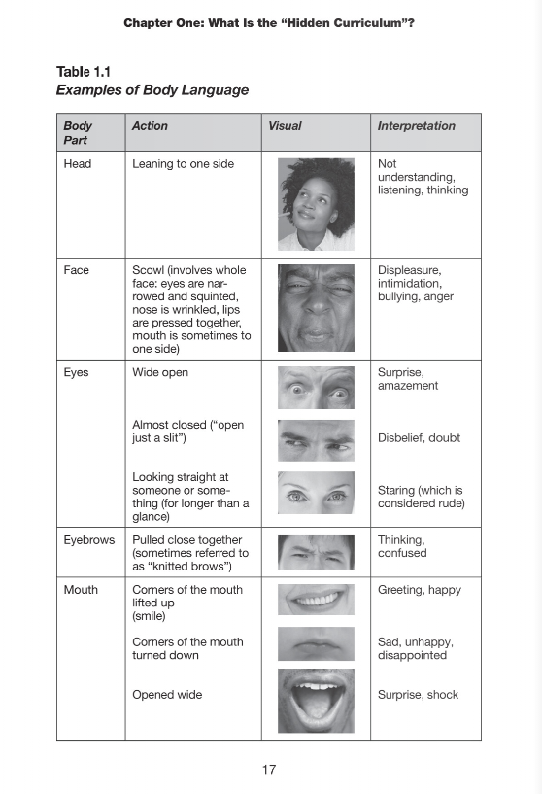
Even if you think someone’s hair is pretty, do not touch it.
Two people can have the same thing (shirt, bag, cell phone, etc.).
Don’t point out ‘funny bumps’ on peoples’ faces or ask them if they have pimples.
Do not tell inappropriate jokes to a group of girls, if you are a boy, such as jokes about private parts, etc.
If you like a boy or girl, you often pretend you don’t like them at all.
Notes:
And look at that! There’s a book called The Hidden Curriculum
Sexual behaviors are social behaviors – I keep saying it but it’s true. I LOVE this book and have used it very often in my practice. Goes over nonverbal communication, slang and their meanings, as well as an extensive list of ‘hidden rules.’ The list is endless but it’s a good place to start
This is a bizarre one that never made sense to me but it’s a rule. Dating is tough for people without disabilities and dating today is very complex with online dating and catfishing. If your child uses technology by themselves, then internet safety is a very important part of sexuality education

Slide 17
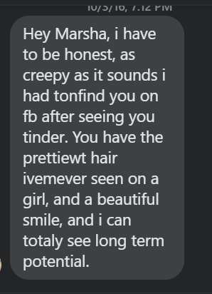
The Internet
Notes:
What could go wrong here ?
Unfortunately we don’t have enough time to go into internet but several of the resources I’ll share with you include internet safety as a teaching topic. Additionally, there are dating websites designed specifically for people with disabilities; I included those in a resource list that I will share out with everyone. As I mentioned, if you child uses technology independently(phone, tablet, computer), this is definitely an important topic to cover and probably an activity you should monitor to a certain degree. Again, we want to be mindful a person’s autonomy but we can’t ignore that fact that’s very easy to get scammed these days

Slide 18
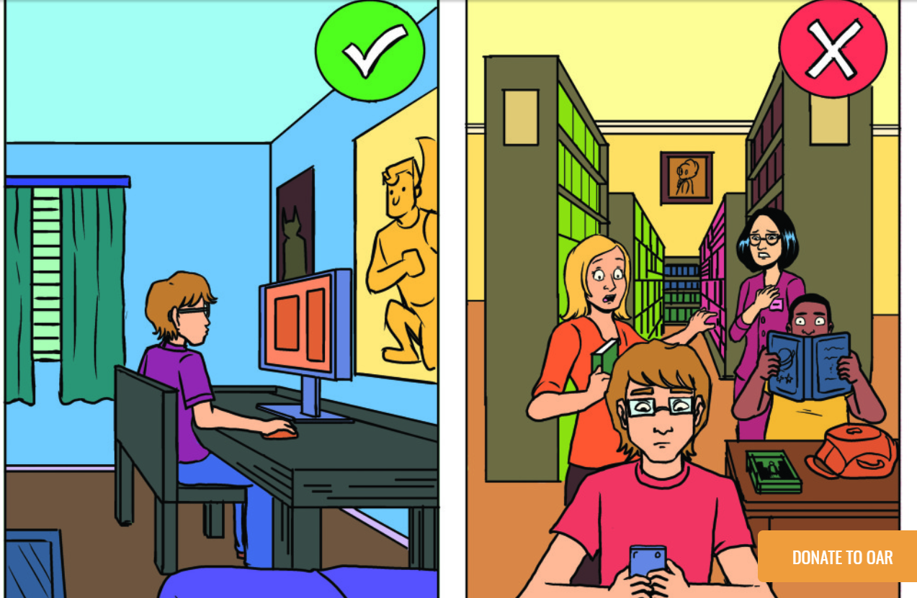
Public v. Private Discrimination
From an early age, have clear and consistent with family rules about privacy
Restrict nudity in public parts of the house
Dress and undress in bedroom or bathroom
Close doors and window shades for private activities
Teach use of robe
Caregivers should model knocking on closed doors before going
From: Sex Ed Guide for Self-Advocates
Notes:
Public v. Private is often one of the first places we start when devling into sex ed. It’s a pretty concrete topic and should be taught when children are still young. You don’t have to wait until they are teenagers! Remember, the ‘need’ for privacy appears when we are still children.
Image is from OAR’s Sex Ed guide – I’ll share more on that later. Shows a young man looking up (presumably) porn at home in his bedroom which is GREAT because he’s in private. But if he decides to look at the same website while in the library – that’s really unexpected and you can see people around him are feeling uncomfortable because he’s doing a private behavior in a public place.

Slide 19
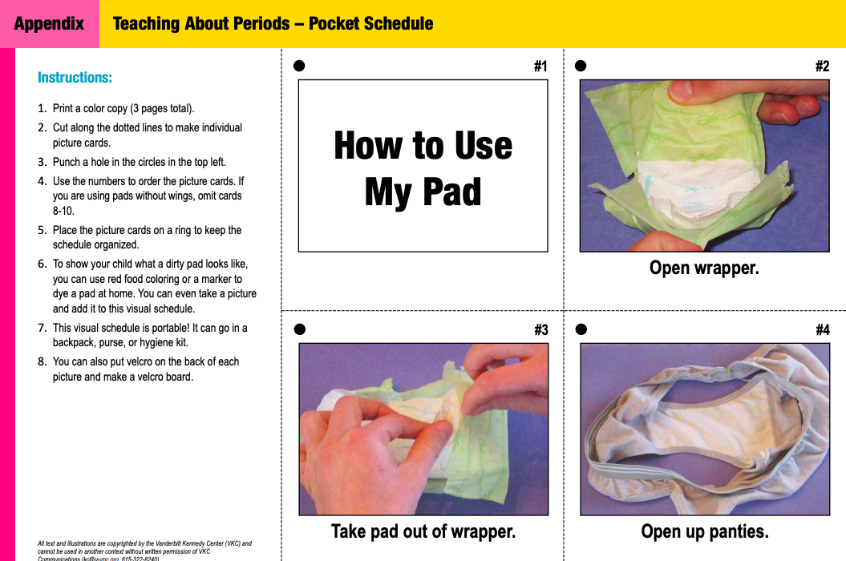
Notes:
I won’t spend too much time on here but I did want to share this specific resource. This part of the Healthy Bodies Toolkit developed by Vanderbilt U. It’s online, FREE, available in Spanish and it’s very awesome. As you can see, they provide a lot of great visuals and easy to follow instructions for parents

Slide 20
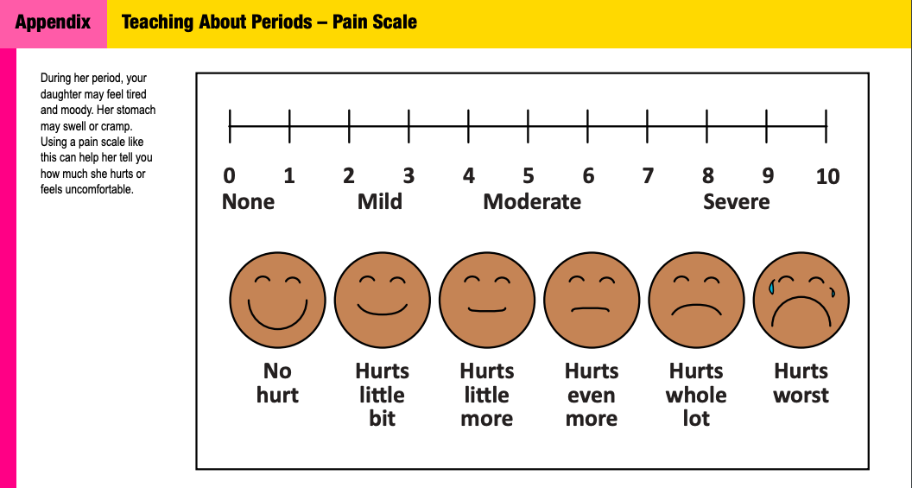
Notes:
And here we have a pain scale for periods. It’s a very comprehensive toolkit.

Slide 21

Be PROACTIVE.
Model positive, appropriate social interactions and behaviors
Give access to privacy
Give age-appropriate information that is modified to meet the learning needs of the individual.
Use visuals, tv shows/movies, role play, etc. Make it fun!
Try to be sex positive – it’s ok to feel embarrassed, unsure, etc. Give yourself space and grace.
Be consistent in approving or disapproving of certain behavior.
Encourage curiosity, independent thinking, problem solving and self-expression
Embrace teachable moments.
Repetition is key.
Incorporate the social dimension of sexuality when and wherever appropriate.
Notes:
We need to be proactive when we’re talking about sex/sexuality education. We should be teaching children how to label their body parts at a young age; we should be teaching public and private before the NEED for privacy arises. More often than not, individuals with ID/D receive sexuality education only after something inappropriate happened – disrobe in public, groped their 1:1; solo sex in public.
Modeling appropriate behaviors and interactions – ask for permission before giving your child a hug; it may seem silly but this is how we teach the concept of consent. When we just grab our child’s hand and say “let’s go” we are modeling that it is OK to touch people without their permission.
We can’t talk about doing private things in private places if we aren’t going to give young people access to privacy. We can’t tell someone you can only have solo sex in your bedroom alone with the door closed but never let them be alone in their bedroom with their door closed. Honestly, most people with ID/D don’t understand privacy the way we do – privacy is an abstract concept to people with disabilities because very rarely are they left completely alone – even when using the toilet or shower. I am guilty of being that teacher with her foot in the door while a student uses the bathroom. Sex education may give language with which to report abuse but privacy awareness gives the concept with which to understand it.
Remember – it’s how we teach, not what we teach. We should not be showing 20 years old cartoon figures of naked bodies. On the other hand, if we are teaching body parts to a 5 year old, then cartoon pictures are ok because it’s age appropriate.
It’s OK to feel embarrassed and unsure. It’s ok to tell your child “we will talk about this later.” The important thing is that you don’t make your child feel shameful. You don’t have to have all the answers. We put a lot of pressure on ourselves to know everything, right away but that’s not realistic. Give yourself space and grace when you don’t know the answer, feel uncomfortable, or frankly don’t feel like having dealing with it.
Use the media, soap opera support group:
The media is here to stay so we can use it as a teaching tool.
One Developmental Disability agency had a soap opera support group.
They would watch a show and then discuss healthy relationships.

Slide 22

The 4 P’s by Terri Couwenhoven
Permission: to discuss, learn about sexuality, and be in a relationship
Privacy: most of our responses and teaching will involve the topic of privacy
Pleasure: Don’t forget to talk about pleasure. Our culture has trouble discussing sexual pleasure, but it is important to be comfortable with this topic as well.
Protection: Don’t forget to mention ways to protect oneself in certain situations
Notes:
Some points to keep in mind when responding to questions and having conversations around sex and sexuality.
Terri is the mother of a young lady with down’s syndrome. She has published man books on sexuality and ID/D. Great resource.

Slide 23
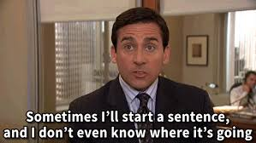
Don’t panic!
  Remember the 3 C’s – Cool, Calm, and Collected
Affirm
  That’s a good/interesting question. Thank you for asking.
Be curious
  What do you think [insert thing] is/means/looks like?
Keep calm, you’re doing great
  It’s OK to acknowledge discomfort, it’s good to share if you’re feeling uncomfortable so it isn’t misinterpreted by your child
Answer the question
  “I don’t know” AND “I need to think about this, let’s finish this talk tomorrow” are perfectly acceptable answers
  Reponses should be positive and non-judgmental; give facts, share your personal values, and offer a range of opinions. EX: some people like to hold hands with their partners and some people don’t. Both are OK
  Consider your child’s age and their individual personality; response for 6 yr old will be different than 16 yr old
  Encourage their feedback – do you understand? Does that make sense?
When responding to questions…
Notes:
1. Reassure person that it is a good question. Being positive makes you askable. It also gives you extra time to think
3. “where did I come from” story. It’s silly joke but it’s true. One of the adults in my old program used to talk about wanting to “go to 3rd base.” One day she asked me if I had been to 3rd base. I said “what do you think 3rd base is?” She blushed immediately and made a kissy face, pointed to her cheek. I said “a kiss on the cheek?” and she nodded. I did not inform her of the more common definition of 3rd base but did say that kisses on the cheek can be really nice and feel really good when it’s from people you care about it and if you give permission for a kiss.
5. Do you understand? Does that make sense?

Slide 24
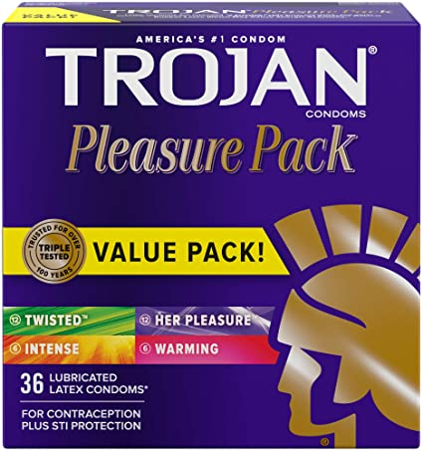
Another framework to help us with answering questions…
Physical -what it is, describe physical aspects
  A rubber sock that covers the penis
Social - private, responsibility, laws
  You use a condom in private. It protects you
  and your partner
Emotional - feelings connected to it
  People feel good when they use condoms because they are being responsible and taking care of themselves and their partner.
Notes:
This method was developed by a lady named Winifred Kempton, she was a sexual health and disability rights advocate
You don’t have answer questions with all these components

Slide 25
Quick Round of Jeopardy…
Physical - When a person touches their private parts
Social - It is something you do in private, some people do it and some people don’t
Emotional - It should make you feel good
MASTURBATION/SOLO SEX

Slide 26

REMEMBER!
You don’t have to tell them everything you know. You ONLY need to share what is relevant to them right now
Notes:
You don’t have to tell them everything you know. You ONLY need to share what is relevant to you right now

Slide 27


Organization for Autism Research Sex Ed Guide (FREE)
https://researchautism.org/sex-ed-guide/
The Healthy Bodies Toolkit (FREE)
https://vkc.mc.vanderbilt.edu/HealthyBodies/
Tom and Ellie series
Amazon.com
Using public bathrooms
Puberty
Solo sex
Notes:
I share these first because they’re most easily accessible….

Slide 28


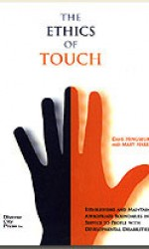
Notes:
More awesome resources

Slide 29
References
American Academy of Pediatrics Committee on Children with Disabilities (1996). Sexuality education of children and adolescents with developmental disabilities. Pediatrics, 97(2), 275-278.
Danya International, Inc. (2014). Charting the Course
Gerhardt, P. (2018). Sexuality & Sexuality Instruction with Learners with Autism Spectrum Disorders and Other Developmental Disabilities.
McLaughlin, K. (2019). Sexuality Education for People with Developmental Disabilities.
National Information Center for Children and Youth with Disabilities (1992). Sexuality education for children and youth with disabilities, 1(3), 1-28.
Planned Parenthood League of Massachusetts. (2020). Sexuality Education for Youth on the Autism Spectrum.

Slide 30
Marsha Stepensky Dorn, MS.Ed, BCBA
Stepenskym@gmail.com
Upcoming Workshops:
June 17 – Sexuality and ID/D
July 20 – Understanding Consent

